Slide 1

Trends in Ratings/review countings of Yelp Data for different cities
“Jimmy” Zhenning Xu
Di Wu
Yong Choi
CSU Bakersfield

Slide 2
Outline
Background about reviews/dataset
Scraping Yelp ratings/review counts from Yelp.com
Analyzing features (ratings, review counts, etc.)
Similarities and differences between different cities

Slide 3
Yelp Dataset
Data for top 50 restaurants were scraped for 5 different cities
Includes reviews, top 50 restaurants, business attributes
Currently, Yelp does not allow us to scrape more than 3 reviews for each restaurant
Focus on reviews counts/ratings of the review text
Find similarities and differences between different cities

Slide 4
Trend analysis
Reviews - Yelp lists the number of reviews under each business listing
Rating - Yelp uses 1-5 Likert Scale for each business
Starting point: Trend analysis
Finding trends of ratings/reviews
By users
By businesses
Find a way to summarize the trends in data
Using homogenous segments

Slide 5
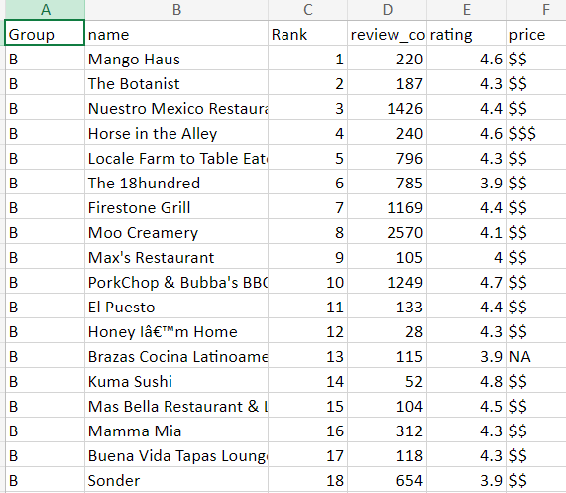
A snapshot of the data for one of the cities

Slide 6
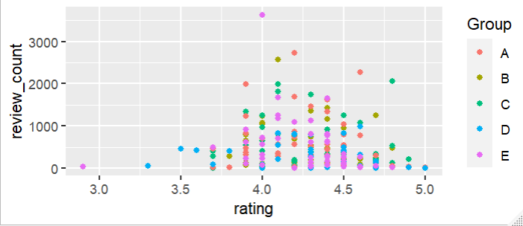
Results - ratings /reviews by city

Slide 7
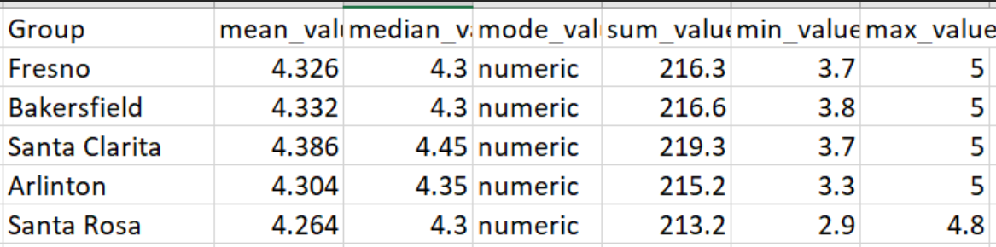
Results - ratings by city

Slide 8
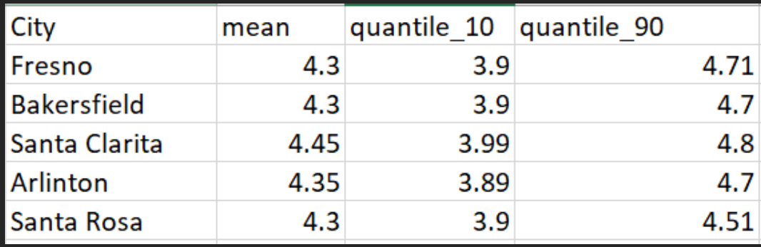
Results - ratings by city - top 10 vs. bottom 10

Slide 9
Results - ratings by city - top 10 vs. bottom 10

Slide 10
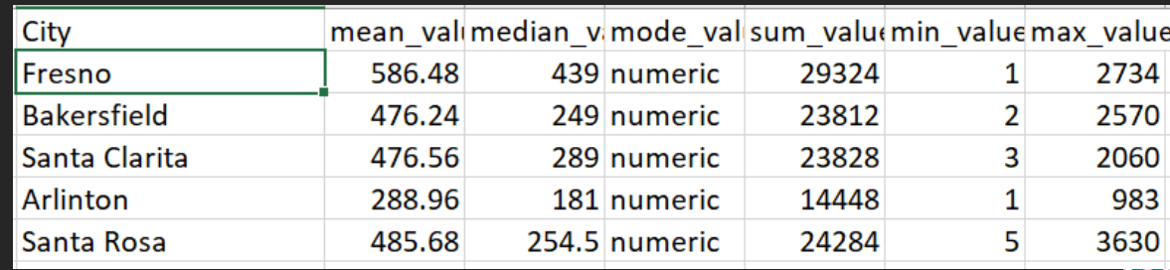
Results - number of reviews by city

Slide 11
This is still an early project idea. Your feedback is highly appreciated.
Thank you all!

